Slide 1
Requirements and System Architecture of the IoT/M2M 物聯網需求與系統架構
行動寬頻尖端技術跨校教學聯盟
國立交通大學資訊工程系
Department of Computer Science
National Chiao Tung University
September 20, 2016

Slide 2
Outline
IoT/M2M System Structure
Introduction to oneM2M
IoT/M2M Use-Case-Driven Requirements
IoT/M2M High Level Architecture
Notes:
大綱
1. 物聯網的系統結構：關於物聯網的一些系統組成、特性以及一些可能面臨的挑戰。
2. oneM2M的介紹
3. 物聯網的使用者需求
4. 物聯網的架構

Slide 3
IoT/M2M System Structure

Slide 4
IoT/M2M System Structure
Application
server
Application
server
Business Applications
Internet
Communication networks
Gateway
Agents/
End Users
device
Scenario 1
M2M agent
Scenario 2
M2M relationship
Scenario 3
M2M area networks
Notes:
M2M的架構圖 reference: <M2M COMMUNICATIONS A SYSTEMS APPROACH>
應用層：可以提供完整服務的應用，例如eHealthCare, Smart Grid, etc..
網路層：M2M強調機器間互相溝通必須要透過Internet。
感測層：主要可分三類 1) 以單一device連上Internet，是最基本的M2M架構 2) 一群devices一起連上Internet，因為沒有透過特殊的Gateway，
所以稱為M2M relationship 3)第三種model的Agents是由一群Devices與Gateway組成。 Agents自己構成一個小型的溝通網路，稱為M2M area network，會透過Gateway連上Internet。

Slide 5
M2M Area Networks
“M2M area network” is introduced by ETSI.
Provide PHY and MAC layer connectivity between M2M devices connected to the same M2M area network
Allow M2M devices to gain access to a public network via a gateway
Gateway
M2M area network

devices + gateway
Notes:
European Telecommunication Standards Institute (ETSI)歐洲電信標準協會
-1988年由歐洲共體委員會建立的非營利性電信標準化組織。
-特性：與ITU(國際電信聯盟)相比 1.具有大眾性和開放性
2.對市場敏感，按照市場與用戶需求制定標準
3.時效性和針對性強
-主要領域：3G, ATM, VoIP, VPN, etc.
M2M區域網路(M2M Area Network)：
由ETSI所提出，提供在實體層相同機器(指機器以同樣的方式傳輸)相互溝通的網路。而要與外界網路溝通，則須經由Gateway。
這樣的M2M區域網路是階層式M2M的一部份。

Slide 6
Introduction to ETSI TC M2M
ETSI (European Telecommunications Standards Institute) TC (Technical Committee) M2M established in Jan 2009
Active delegates from Europe, North America, China, Korea, and Japan
Currently about 30% Operators, 60% Manufacturers and 10% others
8 plenary meetings per year plus numerous ad-hoc meetings and 3-5 conference calls per week
Constantly growing number of documents per meeting (300 +)
Constantly growing plenary participation (70 +)
Growing membership in M2M email list (400+)
Notes:
M2M的Applications可能具有下列特性：
1. devices可能數量很大很多。
那麼要維護這樣大量的機器，處理大量的資料會是M2M Application要面臨的問題（Scalabitily)。
再來，有些應用雖然機器量很多，但每個機器並不是隨時都要用到。例如：感測器可能平時只需要自行蒐集資料，可能每天定時上傳資料到資料庫即可。像這樣的應用，感測器若一直占著頻寬而不上傳資料，這樣是非常浪費的。因此，這也需要一些處理機制。
2. 一個系統可能是由多個異質網路所組成。
那麼異質網路衍生出來的問題會有：資料傳遞的速率問題、延遲和建立一些共有的權限等等，
系統亦必須處理不同的溝通protocols。
3. Transparency的意思是說 M2M Application可以不用透過人進行反應，機器本身就可以做一些簡單及時的處理。例如：eCall就是一個需要快速即時的反應，才能把災害造成的損失降到最低。
4. M2M系統可能擁有一些個人的資訊。保密的問題就需要特別注意了。
5. M2M應用可能包含一些較危急的應用，例如與生命相關的應用，需要注意資料傳輸的即時性與正確性。

Slide 7
Goals of ETSI TC M2M
To develop and maintain an end-to-end overall telecommunication high level architecture for M2M
To identify gaps where existing standards and provide specifications to fill these gaps
Notes:
M2M的Applications可能具有下列特性：
1. devices可能數量很大很多。
那麼要維護這樣大量的機器，處理大量的資料會是M2M Application要面臨的問題（Scalabitily)。
再來，有些應用雖然機器量很多，但每個機器並不是隨時都要用到。例如：感測器可能平時只需要自行蒐集資料，可能每天定時上傳資料到資料庫即可。像這樣的應用，感測器若一直占著頻寬而不上傳資料，這樣是非常浪費的。因此，這也需要一些處理機制。
2. 一個系統可能是由多個異質網路所組成。
那麼異質網路衍生出來的問題會有：資料傳遞的速率問題、延遲和建立一些共有的權限等等，
系統亦必須處理不同的溝通protocols。
3. Transparency的意思是說 M2M Application可以不用透過人進行反應，機器本身就可以做一些簡單及時的處理。例如：eCall就是一個需要快速即時的反應，才能把災害造成的損失降到最低。
4. M2M系統可能擁有一些個人的資訊。保密的問題就需要特別注意了。
5. M2M應用可能包含一些較危急的應用，例如與生命相關的應用，需要注意資料傳輸的即時性與正確性。

Slide 8
Characteristics of M2M
Application
server
Information exchange over communication networks
Via mobile networks or public internets
A group of similar devices
Devices with limited capacities
Hierarchical architecture
Autonomous
Internet (Communication Network)
Gateway
Notes:
M2M特性：
1.資料的互相傳遞(透過Mobile Network 或Public Internets)。
2. 由一群功能類似的devices組成End User端，其中devices可能能力有限。
4.有M2M area network的架構，形成一個階層式的整體。
3.不需要透過人來做回應，加快整體流程的時間。e.g. eCall

Slide 9
Characteristics of M2M Applications
A large amount of devices
Scalability issues
Non-classical usage patterns in mobile networks
E.g., not always active - only be triggered for specific reason and only do things in some fixed time.
A large variety of devices
Diverse requirements, e.g., data exchange rate, latency, reliability
Various wireless communication protocols
Transparency
No need for human interference
High autonomy
Intrusiveness: privacy issues
Criticality: life-savers, life-critical
Notes:
M2M的Applications可能具有下列特性：
1. devices可能數量很大很多。
那麼要維護這樣大量的機器，處理大量的資料會是M2M Application要面臨的問題（Scalabitily)。
再來，有些應用雖然機器量很多，但每個機器並不是隨時都要用到。例如：感測器可能平時只需要自行蒐集資料，可能每天定時上傳資料到資料庫即可。像這樣的應用，感測器若一直占著頻寬而不上傳資料，這樣是非常浪費的。因此，這也需要一些處理機制。
2. 一個系統可能是由多個異質網路所組成。
那麼異質網路衍生出來的問題會有：資料傳遞的速率問題、延遲和建立一些共有的權限等等，
系統亦必須處理不同的溝通protocols。
3. Transparency的意思是說 M2M Application可以不用透過人進行反應，機器本身就可以做一些簡單及時的處理。例如：eCall就是一個需要快速即時的反應，才能把災害造成的損失降到最低。
4. M2M系統可能擁有一些個人的資訊。保密的問題就需要特別注意了。
5. M2M應用可能包含一些較危急的應用，例如與生命相關的應用，需要注意資料傳輸的即時性與正確性。

Slide 10
M2M Devices
Battery powered
E.g., water meters are located outdoors and cannot be easily connected to a power supply.
Embedded
Many devices are deployed in systems with specific operating condition and with limited computation power.
E.g., the OBD in car
Here to stay
Many devices are static or with very low mobility.
Notes:
M2M Device可能具有以下幾個特點：
電力來自於電池，所以可能要考慮電壓小，電力不持久等等的問題。
嵌入式的裝置，因為需要考慮裝置特性，加上每個裝置要做的事情其實並不複雜。因此可能會需要將所有裝置的功能整合並簡化再出產。
許多裝置是不會移動或不會時常移動的，所以不用受到一些行動網路條件的限制。

Slide 11
Challenges
Fragmentation of solutions
It is important to have service platforms that can be reused for multiple applications.
Network misalignment
large numbers of devices generating very small amounts of data transport and potentially a very significant overload of the control and connectivity planes.
Security and Privacy issues
E.g., eHealth, Smart Grid, etc.
Data sharing vs. data protection
Notes:
※M2M可能面臨到的挑戰
1. M2M在發展的過程面臨到的第一個挑戰就是沒有一個統一的架構。
因為M2M發展也有一段時間了，各單位也依照自己的需求設計了屬於自己適合的架構。但缺少了整合，造成了發展或普及的不易。
2. 之前就有提到M2M可能會有相當龐大數量的機器，而網路的負荷就會是一項挑戰，雖然每個感測器都是傳送極少量的資料，但因為機器數量多，還是會有一定的難度(連線次數與Control 訊息會造成網路負擔)。
3. 再來就是一些安全性及隱私權的問題也需要好好維護。

Slide 12
Introduction to oneM2M

Slide 13
Predecessor of oneM2M ETSI TC M2M
ETSI (European Telecommunications Standards Institute) TC (Technical Committee) M2M established in Jan. 2009
To develop and maintain an end-to-end overall telecommunication high level architecture for M2M
To identify gaps with existing standards and provide specifications to fill these gaps
Notes:
ETSI TC M2M於2009年1月成立，為了發展與維護M2M的大致架構、定義物聯網與現有標準間的障礙及提出標準來解決這些問題。

Slide 14














ETSI M2M Network
Client Applications
M2M Area Network
M2M Core Network
M2M
Device
Service
Capabilities
M2M
Gateway
Service
Capabilities
M2M
Network
Service
Capabilities
M2M
Gateway
M2M Applications
M2M Device Domain
M2M Network Domain
M2M Application Domain
Notes:
ETSI的物聯網網路包含三個部分：
M2M Device Domain，由devices所組成，通常為M2M Area Network
Ｍ2M Network Domain，為物聯網的主要核心網路，也就是現有的Internet
M2M Application Domain，由物聯網應用程式與使用者應用程式所組成
其中，M2M Device Domain會透過M2M Gateway連上網路(M2M Network Domain)，而M2M Application Domain則會透過M2M Network Service Cabilities使用核心網路功能。

Slide 15
ETSI M2M Specification Output Release 1 (End of 2011), Release 2 (Early 2013)
TR 101 584
Study on Semantic Support of M2M Data
TR 102 935
Smart Grid
Impacts on M2M
TR 103 167
Threat analysis and counter measures to M2M service layer
TS 103 104
Interoperability Test Specification for CoAP Binding of ETSI M2M Primitives
TR 102 732
eHealth
Stage 1
Stage 2
Stage 3
TR 102 857
Connected
Consumer
TS 102 689
M2M Service Requirements
TS 102 690
M2M Functional Architecture
TS 102 921
M2M Communications, mIa, dIa, mId interfaces
TR 102 898
Automotive
TR 102 725
M2M Definitions
TS 103 092
OMA DM compatible Management Objects
TR 103 118
Smart Energy
Infrastructure security
TR 102 966
Interworking with M2M Area Networks
TS 103 093
BBF TR-069 compatible Management Objects
Use cases
Notes:
ETSI M2M的標準規格包含版本一(2011)與版本二(2013)
TR為Technical Report, TS為Technical Specification, 分別定義了不同部分的物聯網系統架構

Slide 16
Transition from ETSI M2M to oneM2M
ETSI worked with other standard development organizations in the world to launch oneM2M Partnership Project In July 2012
A global Initiative focused on consolidation and standardization of a common M2M Service Layer which can be embedded in hardware or software
Objectives are to enhance interoperability, simplify development of applications, boost economies of scale, and reduce standards overlap.
ETSI M2M technical specifications have been transferred to oneM2M.
ETSI TC M2M has been changed to ETSI TC SmartM2M since November 2013 to focus on EU regulations and verticals.
Notes:
ETSI 從2012年與其他開發組織合作, 共同參與oneM2M 合作計畫, 目標在於發展一套統一的物聯網服務標準, 能夠應用在所有系統或軟體裡, 並且增強其互通性、簡化應用的開發、減少各國標準的重疊部分等等
目前, ETSI M2M 的標準已經被轉移成oneM2M, 而ETSI TC M2M 已經被修改成ETSI TC SmartM2M, 主要符合EU的政策及常規標準.

Slide 17
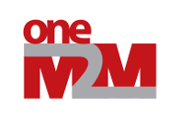














oneM2M Partnership Project
Much like the partnership in 3GPP!
Over 200 member organizations in oneM2M
Japan – ARIB, TTC
USA – ATIS, TIA
China - CCSA
Europe - ETSI
Korea – TTA
Chunghwa Telecom
HTC
III
National Chiao Tung University
Notes:
ATIS Alliance for Telecommunications Industry Solutions USA
ARIB Association of Radio Industries and Businesses Japan
CCSA China Communication Standards Association China
ETSI European Telecommunications Standards Institute European Union
TIA Telecommunications Industry Association USA
TTA Telecommunications Technology Association Korea
TTC Telecommunication Technology Committee Japan
TSDSI Telecommunications Standards Development Society India

Slide 18
The Purpose and Goal of oneM2M
oneM2M technical specifications are to address the need for a common M2M Service Layer that can be readily embedded within various hardware and software, and relied upon to connect the myriad of devices in the field with M2M application servers worldwide.
Initially, oneM2M shall prepare, approve and maintain the necessary set of Technical Specifications and Technical Reports for:
Use cases and requirements for a common set of Service Layer capabilities;
Service Layer aspects with high level and detailed service architecture, in light of an access independent view of end-to-end services;
Protocols/APIs/standard objects based on this architecture (open interfaces & protocols);
Security and privacy aspects (authentication, encryption, integrity verification);
Source: oneM2M
Notes:
oneM2M 主要是為了提出一般化的物聯網服務層之需求, 讓其可以輕易被嵌入到各種不同的硬體與軟體中, 並且能透過此服務層連接大量遍佈世界各地的物聯網應用服務的裝置
最初, oneM2M需要準備、批准並維護必要的TS與TR:
服務層能力的使用者範例與需求
服務層的高層級與詳細的服務架構
根據此架構的Protocols/APIs/標準物件
安全性與隱私方面(認證、加密、完整性驗證) >

Slide 19
The Purpose and Goal of oneM2M (Cont.)
Reachability and discovery of applications;
Interoperability, including test and conformance specifications;
Collection of data for charging records (to be used for billing and statistical purposes);
Identification and naming of devices and applications;
Information models and data management (including store and subscribe/notify functionality);
Management aspects (including remote management of entities); and
Common use cases, terminal/module aspects, including Service Layer interfaces/APIs between Application and Service Layers;
Service Layer and communication functions
Notes:
可達性與發掘應用程式
互用性, 包含測試及規格一致性
計費紀錄的資料收集 ( 用來做計費或統計等等)
裝置與應用程式的識別及命名
資訊模型與資料管理 (包含儲存, 訂閱/通知 功能)
管理方面 ( 包含實體的遠端管理) 及
一般使用案例, 終端/模組方面, 包含應用程式與服務層間的服務層介面/APIs
服務層及通訊方程式

Slide 20
oneM2M Network
Application Dedicated Node
Cloud
A Distributed Application Platform for IoT/M2M
Source: oneM2M
Infrastructure Node
AE
e.g. BLE
AE
AE
Application Service Node
Middle Node
Cloud
API
AE
AE
AE
oneM2Mmessages
oneM2Mmessages
API
API
API
CSE
e.g. WLAN, Zigbee
CSE
e.g. WWAN
CSE
Field Domain
Infrastructure Domain
CSE: Common Services Entity
Notes:
oneM2M的網路架構 , 圖為一物聯網的分散式應用程式平台
最左邊為Field Domain, 包含Application Dedicated Node(單純的具AE功能的節點)及Application Service Node(同時具有AE與CSE功能的節點), AND與ASN會透過WPAN/WLAN與Middle Node(也就是Gateway, 具有AE與CSE功能)溝通
Middle Node則透過網路如WWAN與Infrastructure Node溝通, Infrastructure Node位於Infrastructure Domain, 具有多個AE與CSE的功能, 可以放在雲端提供服務
其中, 資料傳輸會以oneM2M的資料格式傳送.

Slide 21
Technical Report (TR)
Study before standards specifications
These reports are not standards
The ideas, however, lead to standards specifications.
Notes:
技術報告（TR）: 前標準規範的研究，這些報告不是標準但其中的想法引導出標準規範。

Slide 22
Technical Specification (TS)
There are official standards specifications.
It follows three stages of specification from high level to low level
Stage 1: Requirements
Stage 2: Architecture
Stage 3: Interfaces, APIs
Notes:
技術規範（TS）:
這是正式的標準規範。
遵照從高階到低階的三個階段來制定如下規格:
第1階段：系統要求
第2階段：系統架構
第3階段：系統接口界面 ，Application Programming Interface

Slide 23
Release 1 Technical Reports
Notes:
Release 1 的技術報告包含:
TR-0002 架構分析1 : 分析已提出的架構
TR-0001 使用案例
TR-0003 架構分析2: 研究合併已提出的架構
TR-0009 拓樸分析
TR-0006 賦予管理能力的研究: 研究賦予管理能力的技術
TR-0007 抽象與語義
TR-0008 安全性分析: 分析oneM2M安全性的解決方法
TR-0005 角色及專注的領域
TR-0011 使用案例v2
TR-0012 終端對終端的安全性及群組認證

Slide 24
Release 1 Technical Specifications
TS-0001 Functional Architecture
TS-0003 Security Solution
TS-0004 Service Layer Core Protocol
TS-0002 Requirements
TS-0009 HTTP Protocol Bindings
TS-0008 CoAP Protocol Bindings
TS-0010 MQTT Protocol Binding
TS-0006 Managements Enablement (BBF)
TS-0005 Management Enablement (OMA)
TS-0011 Acronyms and Definitions
Release 1 was released on February 4, 2015.
Notes:
Release 1 技術規範, 包含
TS-0001 功能性架構
TS-0002 服務層的核心拓樸
TS-0009 HTT拓樸連接
TS-0008 CoAP拓樸連接
TS-0010 MQTT拓樸連接
TS-0006 管理賦予(BBF): 利用BBF ( Broadband Forum) TR-069 protocol與相關的訊息流程達到oneM2M的管理要求
TS-0005 管理賦予(OMA): 利用OMA(Open Mobile Alliance) DM及OMA LWM2M resource與相關訊息流程達到oneM2M的管理要求
TS-0003 安全性解決方法
TS-0002 要求
TS-0011 縮寫與定義

Slide 25
oneM2M Infrastructure Domain
The infrastructure domain is the M2M core network and normally resides in a cloud environment.
The infrastructure domain can leverage the existing telecom networks including fixed and mobile networks (4G now or 5G in the future). But, mobile networks will be the primary M2M core.
The infrastructure node is the M2M server in the core network.
Common Service Entities (CSE) are network functions defined to support M2M applications.
Notes:
Infrastructure Domain為物聯網核心網路且一般存在於雲端環境, 可以影響目前現存網路包含固定網路及行動網路(4G或未來的5G), 其中, 行動網路將會是M2M的主要核心
而infrastructure node 是核心網路中的M2M伺服器

Slide 26
oneM2M Field Domain
The field domain is the M2M area network and normally resides at the edge of the network.
The field domain employs a large variety of wireless and wireline protocols and technologies.
The field domain consists of both M2M devices and gateways.
M2M devices have two types: Application Dedicated Node and Application Service Node.
M2M gatweays are also called Middle Nodes.
Notes:
Field domain則是物聯網的area network, 一般存在於網路的邊緣, 他利用了大量的無線及有線的protocols及技術
Field domain 包含物聯網裝置及閘道器, 裝置部分包含Application Dedicated Node 及Application Service Node兩種, 閘道器則又稱為Middle Nodes.

Slide 27
Importance of oneM2M Work
Create a common service layer for mass-scale M2M applications, covering all domains of M2M, not just one domain in particular.
It hides the complexity of network usage from applications, thus simplifying the implementation burden for application developers.
The service layer also controls when communications occur, depending on factors such as the time-sensitivity of communications and the economics of data transfer.
Notes:
oneM2M的重要性
建立一般化服務層供大規模物聯網應用程式使用, 包含物聯網所有領域
隱藏網路使用的複雜度, 簡化應用程式的實作
服務層也能根據因子像是時間敏感性及節省資料傳輸進控制

Slide 28
Why M2M Common Service Layer
Enable the development of M2M applications by focusing on high level functionality than lower level tasks like network access control, authentication or routing.
Enable data retrieval and control of sensors by any application via a common horizontal service layer.
Provide network-based services such as charging, security, data publication and subscription. (by infrastructure node)
Notes:
為什麼需要 M2M系統級架構:
藉著專注於高階而不是低階如網路接取控制，身份驗證或路由的功能，來 鼓 勵 M2M應用的發展 。
使得任何應用通過一個共同的橫向服務層即可執行傳感器的數據檢索和控制。
提供如數據的發布和訂閱等基於網路的服務功 能 。

Slide 29
Common Horizontal Service Layer
SMART
GRID
CONNECTED
VEHICLE
E-HEALTH
CONNECTED
HOME
Vertical
Specific
APIs
M2M Core Needs
M2M Common ICT Services for Vertical Domains
Required
Standards
29
Notes:
圖示多種應用共通的橫向服務層。
列舉了四種應用如Smart Grid, Connected Vehicle, E-health, Connected Home, 這些應用會通過垂直的特定APIs去使用M2M Core Needs

Slide 30
Future Vision
Applications
Applications
Applications
Applications
Common Service Layer
Network Domain
Converged Network Domain
Devices
Gateway
Devices
Devices
Devices
Devices
Present
Future
Notes:
未來會將網路的部分再細分為服務層、網路層(含Gateway)

Slide 31
IoT/M2M Use-Case-Driven Requirements

Slide 32
What is a Use Case?
A use case describes the interactions between one or more actors and the system under consideration for achieving certain functions.
Actors can be a device or a person outside the system.
The system is treated as a black box where the physical architecture of the system is not important.
Notes:
什麼是用例？
用例描述一個或多個參與者和所關切的系統間為實現某些功能而有的相互作用。
參與者可以是系統外的一個設備或一個人。
該系統被視為一個黑盒子 ，系統其中的實際結構並不重要。

Slide 33
Use Cases to Derive oneM2M Requirements in TR-0001
Energy | Wide area energy related measurement & control system for transmission and distribution | Analytics for oneM2M | Smart Meter Reading | Environmental Monitoring for Hydro-Power Generation using Satellite M2M | Oil and Gas Pipeline Cellular/Satellite Gateway
Enterprise | Smart building
Healthcare | M2M Healthcare Gateway | Wellness services
Public Services | Street Light Automation | Devices, Virtual devices and Things | Car/Bicycle Sharing Services | Smart parking
Residential | Home Energy Management | Home Energy Management System | Plug-In Electrical Charging Vehicles and power feed in home scenario | Real-time Audio/Video Communication | Event Triggered Task Execution
Transportation | Vehicle Diagnostic & Maintenance Report | Remote Maintenance services | Neighborhood Alerting on Traffic Accident | Fleet management service using Digital Tachograph
Other | Extending the M2M Access Network using Satellites | Peer communication between M2M devices | M2M data traffic management by underlying network operator | Collection of M2M system data | Optimizing connectivity management parameters with mobile networks | Optimizing mobility management parameters with mobile networks | Sleepy nodes
Notes:
TR-0001中, 使用案例衍生為oneM2M要求的部分
以不同應用類別為區分, 紅色格子的使用範例會於後面的投影片做說明

Slide 34
Methodology Used by oneM2M
Use of a Template to Describe Use Case
Description
Source
Actors
Pre-conditions
Triggers
Normal Flow
Alternative flow
Post-conditions
High Level Illustration
Potential Requirements
Notes:
oneM2M使用的方法原則 :
使用一個固定模式來描述用例如下 -
用例描述
使用案源
利益相關者
情境案例說明
情境觸發
一般流程
其他流程
使用後情況
高層級解說
潛在的新要求

Slide 35
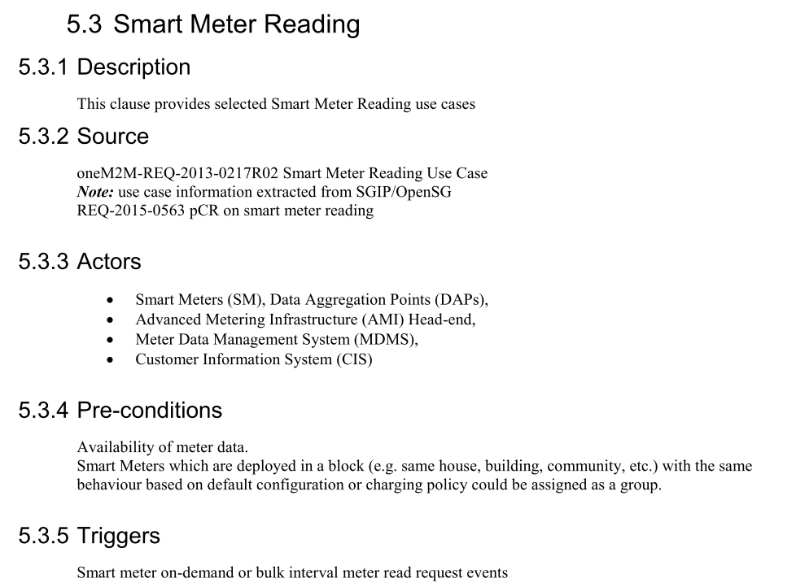
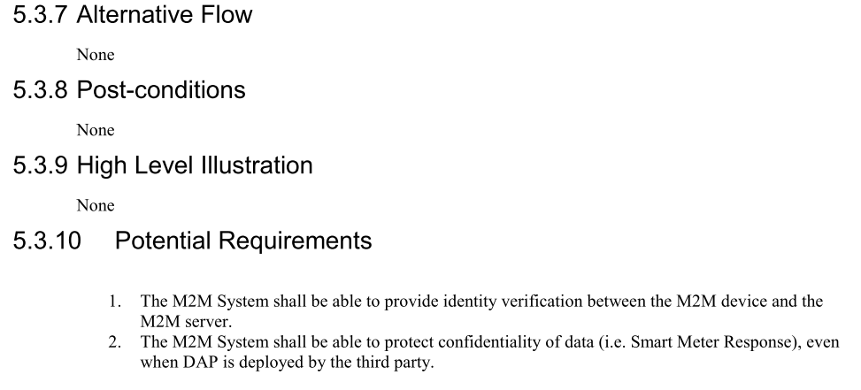
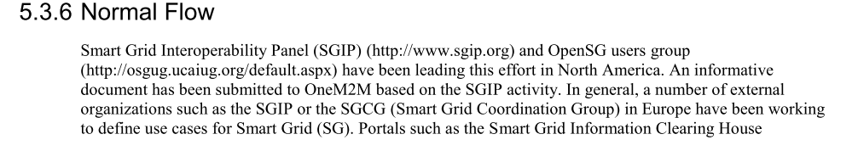
Smart Metering Reading Use Case

Slide 36
Smart Metering Reading Use Case (1) Conceptual Actors/Data Flow Diagram
Source: oneM2M TR-0001
Notes:
Smart Metering Reading 使用案例, 圖為概念上的流程圖:
縮寫解釋:
Smart Meters (SM)
Data Aggregation Points (DAPs)
Advanced Metering Infrastructure (AMI) Head-end
Meter Data Management System (MDMS)
Customer Information System (CIS)
HAN Home Area Network
Ref: http://www.onem2m.org/images/files/deliverables/Release2/TR-0001-Use_Cases_Collection-V2.4.1.pdf

Slide 37
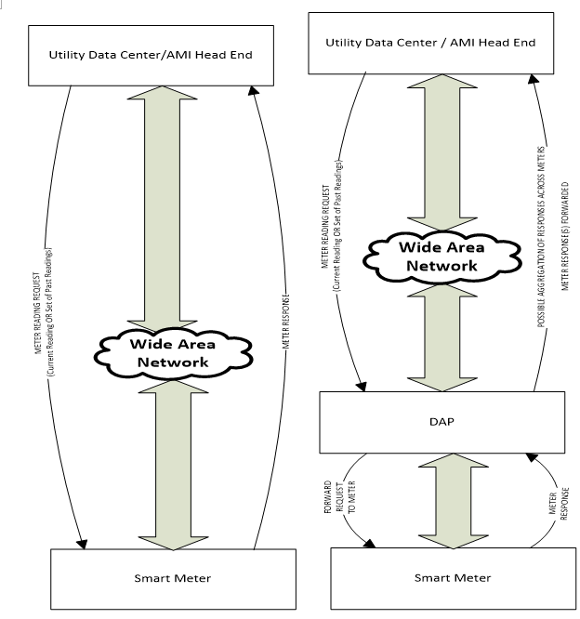
Smart Metering Reading Use Case (2) Typical Smart Meter Reading Flows A (on left) and B (on right)
Source: oneM2M TR-0001
Notes:
典型的Smart Meter Reading流程圖 A (左側), B(右側)
其中每一個element都是一個actor, 利用圖中的data flows與其他actor溝通.
如右圖, Smart Meter 與其他actors溝通, 例如Data Aggregation Point(DAP, 位於AMI Network中). DAP可以將聚集起來的資料透過Wide Area Network傳到Utility Service Provider. meter reading 資訊可以透過AMI Headend (可以轉送資訊到MDMS-與CIS協調, 可以用來儲存/取得 meter data來產生使用者費用資訊-) 抵達data center
左圖則是省略的DAP.

Slide 38
Normal Flow
Two possible flows
flow A: the Utility Data Center / AMI Headend can make a request to the Smart Meter directly.
flow B, the Utility Data Center / AMI Headend can make a request to the Smart Meter that can be received via the DAP
DAP may help distribute requests to all Smart Meters
Or DAP may simply act as a router (forwarding unit)
DAP entity may be either a physical or virtual processing entity buffering and aggregating meter reading responses

Slide 39
Normal Flow Summary
Meter reading requests could request a single meter reading or a set of meter readings
Requests may occur a few times (typically < 10) per day and can be of the order of a few tens of bytes.
Meter reading responses can be of the order of a few 10s to 100s of bytes
Meter reading responses are typically expected in the order of a few seconds

Slide 40
Wellness Service Use Case (1)
7.2.1 Description
This use case introduces several services based on wellness data collected by wellness sensor devices via mobile device such as smartphones and tablets which is regarded as M2M gateway.
Some wellness sensor devices are equipped with M2M area network module and measure individual wellness data. The mobile device connects to the wellness sensor devices by using the M2M area network technology, collecting and sending the wellness data to application server.
It is important to consider that mobile device as M2M gateway has mobility. For instance, there are possibilities for a mobile device to simultaneously connect to many wearable wellness sensor devices, and to connect newly to wellness sensor devices which have never connected previously at the location of outside.
This use case illustrates potential requirements from the use case of wellness services utilizing mobile device.
7.2.2 Source
KDDI (TTC)
7.2.3 Actors
M2M Device: wellness sensor device is blood pressure sensor, heart rate sensor and weight scale, for example. It can measure wellness data of users, may be multi-vendor, and equipped with several kind of communication protocol.
M2M Area Network: network which connects between M2M device and M2M gateway.
M2M Gateway: mobile device (e.g. a smart phone) which can receive wellness data from wellness sensor devices and communicate with application servers.
Mobile Network: network which has functions to communicate wellness data and control message between M2M gateway and M2M service platform.
M2M Service Platform: platform where management server is located and which is used by the Application Server to communicate with the M2M Gateway.
Management Server: server which manages the gateway such as mobile device, and controls its configuration such as installing/uninstalling applications.
Application Server: server which serves the wellness services such as indicating the graph of wellness data trend.
Note: Definition of some words is in discussion. Therefore, the description of these actors may change.
Source: oneM2M TR-0001
Notes:
健康服務的使用案例
介紹數種wellness service, 這些服務為將行動裝置如手機等視為M2M gateway, 使用wellness sensor devices收集資訊與提供應用.
Actors:
M2M Device: 感測器裝置, 如血壓感測器, 心跳感測器等等. 主要用來量測使用者健康資訊, 可能由不同廠商製作, 且具有多種通訊protocol.
M2M Area Network: M2M device 與M2M Gateway間的網路.
M2M Gateway: 行動裝置(如手機), 可以從感測器接收資料並與應用程式伺服器溝通.
Mobile Network: 位於M2M Gateway與M2M Service Platform間的網路, 具有傳輸健康資訊與控制訊息的功能
M2M Service Platform: 管理伺服器位於的平台, 且能被應用伺服器用來與M2M Gateway溝通.
Management Server: 用來管理行動裝置並控制其設定(如安裝/解除安裝應用程式)的伺服器.
Application Server: 提供健康服務如顯示健康資訊的趨勢圖的伺服器

Slide 41
Description
Use case of wellness services utilizing mobile device
Services based on wellness data collected by wellness sensor devices via mobile devices (smartphones, tablets) which are regarded as M2M gateways.
Mobile devices collect and send wellness data to application server

Slide 42
Actors
M2M Device: 感測器裝置, 如血壓感測器, 心跳感測器等等. 主要用來量測使用者健康資訊, 可能由不同廠商製作, 且具有多種通訊protocol.
M2M Gateway: 行動裝置(如手機), 可以從感測器接收資料並與應用程式伺服器溝通.
Mobile Network: 位於M2M Gateway與M2M Service Platform間的網路, 具有傳輸健康資訊與控制訊息的功能
M2M Service Platform: 管理伺服器位於的平台, 且能被應用伺服器用來與M2M Gateway溝通.
Management Server: 用來管理行動裝置並控制其設定(如安裝/解除安裝應用程式)的伺服器.
Application Server: 提供健康服務如顯示健康資訊的趨勢圖的伺服器

Slide 43
Wellness Service Use Case (2)
7.2.4 Pre-conditions
Wellness sensor devices are able to establish a connection to the mobile device in order to send wellness data to M2M Service Platform or Application Server. It is first time to associate the mobile device with the wellness sensor devices.
7.2.5 Triggers
New wellness sensor devices such as weight scale are detected by mobile device. User tries to associate the detected devices. Examples are below:
User buys several kind of wearable wellness sensor devices such as blood pressure sensor, heart rate sensor. In order to start monitoring vital data using these sensors, User tries setting of these devices simultaneously. Note that please refer to [i.4] ETSI TR 102 732 “Use cases of M2M applications for eHealth”. (Normal Flow)
User buys wellness sensor devices such as weight scale, and newly deploys them at User’s house to check the wellness status daily. (Normal Flow)
User goes to a fitness center to do exercise and checks the effect by utilizing equipment which is owned by fitness center and has never connected to User’s mobile device. (Alternative Flow 1)
7.2.6 Normal Flow
Usually wellness sensor devices are bought by Users. These devices are deployed in User’s house, or are worn with User.
The mobile device detects new wellness sensor devices and tries to connect to it under User’s permission to connect (pairing between sensor device and mobile device).
The mobile device has established a connection to the wellness sensor device, and then the mobile device receives additional information of the wellness sensor device (e.g. type of device, service certificates of the device, required application software …).
The mobile device is provided with the appropriate application software from the Management Server and is appropriately configured by the Management Server.
When the User measures the data by using wellness sensor device, the mobile device collects the data and sends it to the Application Server.
Source: oneM2M TR-0001
Notes:
Pre-conditions: Wellness sensor deivces可以與行動裝置建立連線, 用來傳輸資料到M2M Service Platform或Application Server.
Triggers: 新的健康感測器(如weight scale) 被行動裝置偵測到, 使用者試圖聯繫此感測器:
使用者購買許多感測器裝置, 為了能夠取得感測資料, 使用者試圖同時設定這些裝置
使用者購買了感測器裝置如weight scale, 並且布置到家裡來確認日常健康狀況
使用者到健身中心運動並透過使用裝備來確認效果( 裝備由健身中心所擁有且從未連接過使用者的行動裝置)
Normal Flow: 一般狀況下, 感測裝置通常由使用者購買並安裝在使用者家中或穿戴在使用者身上:
行動裝置偵測到新的健康感測裝置, 且試圖在使用者的允許下建立連線(配對感測裝置與行動裝置)
行動裝置建立連線後, 會收到感測裝置額外的資訊( 如裝置類型, 服務認證, 需要的應用程式等等)
行動裝置會與合適的應用程式軟體一同由Management Server提供且得到合適的設定
當使用者透過健康感測器量測資料時, 行動裝置會收集資料並送到Application Server

Slide 44
Pre-conditions and Triggers
Pre-conditions: Wellness sensor devices可以與行動裝置建立連線, 用來傳輸資料到M2M Service Platform或Application Server.
Triggers: 新的健康感測器(如weight scale) 被行動裝置偵測到或使用者試圖聯繫此新的感測器:
使用者購買許多感測器裝置, 為了能夠取得感測資料, 使用者試圖同時設定這些裝置
使用者購買了感測器裝置如weight scale, 並且布置到家裡來確認日常健康狀況
使用者到健身中心運動並透過使用裝備來確認效果( 裝備由健身中心所擁有且從未連接過使用者的行動裝置)

Slide 45
Normal Flow
一般狀況下, 感測裝置通常由使用者購買並安裝在使用者家中或穿戴在使用者身上:
行動裝置偵測到新的健康感測裝置, 且試圖在使用者的允許下建立連線(配對感測裝置與行動裝置)
行動裝置建立連線後, 會收到感測裝置額外的資訊( 如裝置類型, 服務認證, 需要的應用程式等等)
行動裝置會與合適的應用程式軟體一同由Management Server提供且得到合適的設定
當使用者透過健康感測器量測資料時, 行動裝置會收集資料並送到Application Server

Slide 46
Wellness Service Use Case (3)
7.2.7 Alternative flow
Alternative Flow 1
As indicated in the Normal Flow, usually the wellness service collects the data from wellness sensor devices which the User owns.
When the mobile device is brought outside, there is an opportunity to connect new wellness sensor devices (e.g. blood pressure which is set in fitness center).
The mobile device detects new wellness sensor devices and tries to connect to them under User’s permission to connect.
The mobile device has established a connection to the wellness sensor device and then the mobile device receives additional information of the wellness sensor device (e.g. type of device, service certificates of the device, required application software …).
The mobile device is provided with the appropriate application software and is appropriately configured by the Management Server.
When the User measures the data by using wellness sensor device, the mobile device collects the data and sends it to the Application Server.
Source: oneM2M TR-0001
Notes:
另一種流程
如同一般流程所說, 通常健康服務會蒐集從感測器偵測而來的資料, 且感測器通常屬於使用者本身
當行動裝置被攜帶出門, 很有機會與新的感測裝置連接( 如健身中心的血壓器)
行動裝置身側到新的健康感測裝置, 並試圖在使用者同意下與之連線
行動裝置建立連線後, 會收到感測裝置額外的資訊( 如裝置類型, 服務認證, 需要的應用程式等等)
行動裝置會與合適的應用程式軟體一同由Management Server提供且得到合適的設定
當使用者透過健康感測器量測資料時, 行動裝置會收集資料並送到Application Server

Slide 47
Alternative Flow
Alternative flow 1
如同一般流程所說, 通常健康服務會蒐集從感測器偵測而來的資料, 且感測器通常屬於使用者本身
當行動裝置被攜帶出門, 很有機會與新的感測裝置連接( 如健身中心的血壓器)
行動裝置身側到新的健康感測裝置, 並試圖在使用者同意下與之連線
行動裝置建立連線後, 會收到感測裝置額外的資訊( 如裝置類型, 服務認證, 需要的應用程式等等)
行動裝置會與合適的應用程式軟體一同由Management Server提供且得到合適的設定
當使用者透過健康感測器量測資料時, 行動裝置會收集資料並送到Application Server

Slide 48
Alternative Flow
Alternative flow 2
Wellness service是一收費服務，使用者選購並在Application Server上建立了帳號
使用者第一次使用需激活Application Server上的服務
當mobile device偵測到wellness sensor devices會要求Management Server提供適當的application來設定
Management Server確定使用者有購買此service並已激活
有的話就由application server提供服務

Slide 49
Alternative Flow
Alternative flow 3
使用者已收集完資料，要mobile device與wellness sensor device斷線，並停用service
如果mobile device不在M2M Area Network範圍內， mobile device自動與wellness sensor device斷線
使用者可主動將mobile device與wellness sensor device斷線或等一段時間後sensor自動斷線
使用者可向Application Server取消服務，Management Server會跟Application Server確認，並de-activate或移除mobile device上的應用程式

Slide 50
Home Energy Management Use Case (1)
9.1.1 Description
This use case is to manage energy consumption at home so that consumers can be aware of their daily home energy consumptions and able to control this consumption by remote actions on home appliances. Innovative services can be developed from the data (energy) collection and sent to either the consumers/ equipment or to Business-to-Business market.
The use case focuses on a home Energy Gateway (EGW) that collects energy information from the electrical home network and communicates it to an M2M system for aggregating and processing of the data. Services can then be developed from the collected data.
The EGW performs an initial treatment of the data received from various sources (sensors, context) as follows:
aggregating and processing the obtained information:
sending some information to the remote M2M system e.g. sending alerts through the M2M system
using some information locally for immediate activation of some actuators/appliances
Is connected (wirelessly or via wireline) to home devices, including the home electrical meter, for information on global or individual consumption of the appliances
Providing displayable consumed energy-related information to the end-user/consumer terminals (PC, mobile phone, tablet, TV screen, etc)
Ref:[i.6] {HGI-GD017-R3 (Use Cases and Architecture for a Home Energy Management Service}
Source: oneM2M TR-0001
Notes:
家裡用電量管理使用案例
此案例是用來管理家裡耗電量, 因此客戶可以注意家中的日常用電量且能透過遠端控制家電來掌控耗電量. 創新服務為透過data(電量) 收集與傳送資料至使用者/設備/ 或Business-to-Business market來開發
使用案例主要為家中Energy Gateway (EGW), EGW會從electrical home network蒐集電量資訊並且與M2M system溝通來聚集/處理這些資料. 服務便可由這些蒐集的資料來發展與提供
EGW負責對data(從不同地方蒐集而來, 如sensor, context) 做第一線的處理:
聚集並處理收集到的資料
傳送資訊到遠端的M2M系統
直接使用這些資訊, 讓一些actuators/appliances能夠做立即的動作
會和家裡的裝置連接, 包含electrical meter
提供可顯示電量數據, 由使用者的終端裝置顯示( 如PC, 手機, 平板, 電視螢幕等等)

Slide 51
Description
家裡用電量管理使用案例
此案例是用來管理家裡耗電量, 因此客戶可以注意家中的日常用電量且能透過遠端控制家電來掌控耗電量. 創新服務為透過data(電量) 收集與傳送資料至使用者/設備/ 或Business-to-Business market來開發
使用案例主要為家中Energy Gateway (EGW), EGW會從electrical home network蒐集電量資訊並且與M2M system溝通來聚集/處理這些資料. 服務便可由這些蒐集的資料來發展與提供
EGW負責對data(從不同地方蒐集而來, 如sensor, context) 做第一線的處理:
聚集並處理收集到的資料
傳送資訊到遠端的M2M系統
直接使用這些資訊, 讓一些actuators/appliances能夠做立即的動作
會和家裡的裝置連接, 包含electrical meter
提供可顯示電量數據, 由使用者的終端裝置顯示( 如PC, 手機, 平板, 電視螢幕等等)

Slide 52
Home Energy Management Use Case (2) Home Energy Management Normal Flow
Source: oneM2M TR-0001
Notes:
此為Home Energy Management 使用案例的一般流程圖
虛線為非必要的flow

Slide 53
Normal Flow
HEM application (M2M device) subscribe to System Operator/SP for information from home device(s).
Information from devices which could be M2M devices (smart meters, electric lightening, fridge, washing machine etc.) at home is collected by the Energy Gateway Operator (EGW) via communication network operator. Information may include room, temperature, occupancy, energy consumption.
Collected information is stored in the EGW SP and may be processed at energy gateway. As a result, control message may be sent back to device from the energy GW depending on policies stored in the energy gateway.
Collected information may also be sent to system operator which contains the M2M service platform for storage via communication network.
Subscribed application (HEM) is notified information is available for processing. Its subscribe M2M operator can process the information before sending to HEM application depending on subscription profile.
HEM application reacts to the shared /collected information and can send control message (e.g. To switch a home device e.g. light /appliance or washing machine) via the system operator.
Control is propagated back through different operator to appropriate M2M device(s).

Slide 54
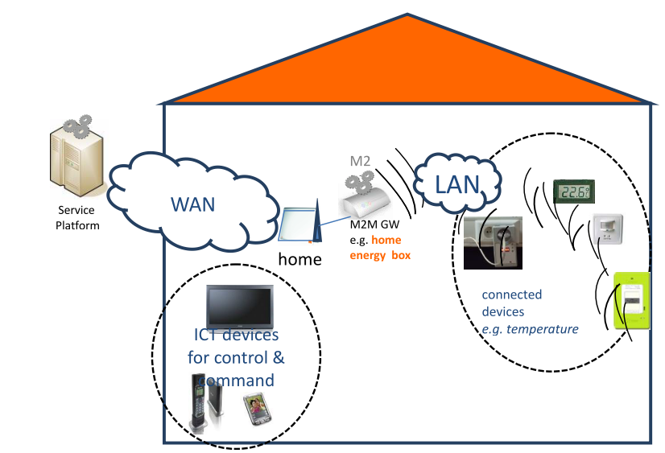
Home Energy Management Use Case (3) Home Energy Management High Level Illustration

Slide 55
TS-0002 M2M Requirements
Major categories of requirements
OSR 72 agreed requirements Overall System Requirements
MGR 17 agreed requirements Management Requirements
ABR 03 agreed requirements Abstraction Requirements
SMR 07 agreed requirements Semantics Requirements
SER 26 agreed requirements Security Requirements
CHG 06 agreed requirements Charging Requirements
OPR 06 agreed requirements Operational Requirements
CRPR 05 agreed requirements Comm. Request Processing Requirements
NFR 02 agreed requirements Non Functional Requirements
Notes:
TS-0002 物聯網需求
需求的主要分類
OSR 72個認同的需求 整體系統需求
MGR 17個認同的需求 管理需求
ABR 3個認同的需求 抽象概念需求
SMR 7個認同的需求 語意需求
SER 26個認同的需求 安全性需求
CHG 6個認同的需求 計費需求
OPR 6個認同的需求 操作上需求
CRPR 5個認同的需求 通訊, 要求處理需求
NFR 2個認同的需求 非功能性需求

Slide 56
Examples of requirements
[OSR-001] The M2M System shall be able to allow communication between M2M Applications in the Network Domain & M2M Applications in the Device Domain by using multiple communication means based on IP access.
[MGR-007] The M2M System shall provide the capability for monitoring and diagnostics of M2M Gateways/Devices in M2M Area Networks.
[SER-008] The M2M system shall support countermeasures against unauthorized access to M2M services and M2M application services.
Notes:
需求範例
[OSR-001] M2M系統必須能夠讓在Network Domain中的M2M Applications及在Device Domain中的M2M Applications使用多種溝通方法(基於IP)溝通
[MGR-007] M2M系統必須提供對M2M Area Networks中M2M Gateways/Device進行監測與診斷的能力
[SER-008] M2M系統必須支援對於非授權存取M2M 服務與M2M應用服務的對策

Slide 57
IoT/M2M High Level Architecture
Notes:
IoT/M2M高層結構

Slide 58
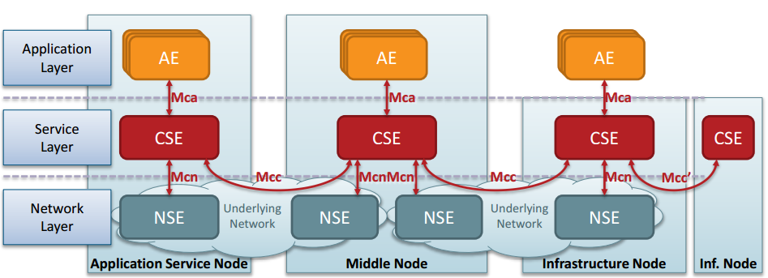
oneM2M Functional Architecture
AE: Application Entity
CSE: Common Service Entity
NSE: Network Service Entity
A Distributed Application Platform for IoT/M2M
Source: oneM2M
Notes:
oneM2M 功能性架構
圖為IoT/M2M 分散式應用平台
主要分為三種Node: Application Service Node, Middle Node,及Infrastructure Node.
其中每個Node中又分為 Application Layer, Service Layer及Network Layer.
AE與CSE間透過Mca溝通
CSE與NSE間透過Mcn溝通
CSEs間透過Mcc互相溝通
而Inf. Node間的CSEs則是透過Mcc'溝通

Slide 59
oneM2M Functional Architecture (Cont.)
Specified in oneM2M TS-0001.
Three layers of architecture: Application Layer, Service Layer and Network Layer
Three types of entities:
AE: Application Entity
CSE: Common Service Entity
NSE: Network Service Entity
Four types of nodes: : Application Dedicated Node, Application Service Node, Middle Node and Infrastructure Node.
Four Reference Points: Mcc (CSE-CSE), Mca (CSE-AE), Mcn (CSE-NSE) and Mcc’ (between 2 service providers).
Mch, for charging, is also defined (but not shown here) between the IN-CSE and a charging server.
Notes:
IoT/M2M高層結構:
定義在oneM2M TS-0001內
三層架構: 應用層, 服務層跟網路層
三種Entity: Application Entity(AE), Service Entity(CSE), Network Service Entity(NSE)
四種Node: Application Dedicated Node(ADN), Application Service Node(ASN), Middle Node(MN), Infrastructure Node(IN)
四種Reference Point: 不同Entity交換的介面, Mcc (兩個CSE間), Mca(CSE與AE間), Mcn( CSE與NSE間), Mcc’(兩個服務提供者之間)
另外還有Mch(IN-CSE與計費伺服器間, 用來計費使用)

Slide 60
What Are M2M Common Service Entity (CSE)?
M2M common service entity can reside in Application Service Node, Middle Node and Infrastructure Node.
There are 12 common functions defined in oneM2M CSE.
Notes:
M2M服務功能是什麼？
M2M服務功能可以位於Application Service Node, Middle Node, 及Infrastructure Node, 總共有12種一般服務被定義在oneM2M CSE內

Slide 61
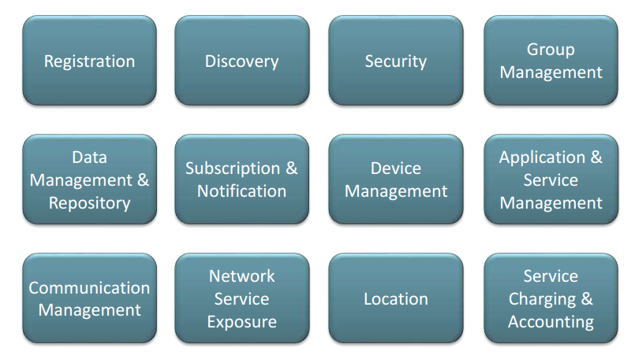
oneM2M Common Service Functions
A Distributed Application Platform for IoT/M2M
Source: oneM2M
Notes:
oneM2M 一般服務功能
註冊
發掘
安全
群組管理
資料管理與儲存
訂閱與通知
裝置管理
應用程式與服務管理
通訊管理
網路服務 exposure
位置
服務計費與結帳

Slide 62
Samples of oneM2M Common Service Functions
Registration CSE-CSE Registration, AE-CSE Registration, …
Discovery Discovery of entities and information/resources
Security confidentiality, integrity, availability, credential/key management, encryption, privacy, authentication, authorization
Group Management Management of groups, support of bulk operations and access
Device Management Firmware updates, configuration settings, topology management, Software installation, logging, monitoring, diagnostics, Reuse of existing DM technologies
Subscription & Notification
Support of event-related notifications (change of values)
Network Exposure Abstraction of the underlying network interface, (eg. usage of remote device triggering, location services, …)
Comm. Management Selection of communications channels, scheduling, Store-and-forward, reachability status awareness
Location Manages and provides location information services
Notes:
oneM2M 一般服務功能的範例
註冊: CSE對CSE註冊(MN-CSE對IN-CSE), AE對CSE註冊 等等
發掘: 發掘實體與資訊/資源
安全性: 機密性, 一致性, 可取得性, 憑證/鑰匙管理, 加密, 私密性, 認證, 授權
群組管理: 管理群組, 支援大量操作與存取
裝置管理: 韌體更新, 設定, topology管理, 軟體安裝, 紀錄, 監測, 診斷, 現有裝置管理技術的重用
訂閱與通知:支援事件相關的通知(改變數值時)
網路揭發: 抽象畫底層的網路介面( 如使用遠端裝置觸發, 位置服務等)
通訊管理: 選擇通訊頻道, 排程, 儲存與轉送, reachability status awareness
位置: 管理與提供位置資訊服務

Slide 63
Samples of oneM2M Common Service Functions
註冊: CSE對CSE註冊(MN-CSE對IN-CSE), AE對CSE註冊 等等
發掘: 發掘實體與資訊/資源
安全性: 機密性, 一致性, 可取得性, 憑證/鑰匙管理, 加密, 私密性, 認證, 授權
群組管理: 管理群組, 支援大量操作與存取
裝置管理: 韌體更新, 設定, topology管理, 軟體安裝, 紀錄, 監測, 診斷, 現有裝置管理技術的重用
訂閱與通知:支援事件相關的通知(改變數值時)
網路揭露: 抽象畫底層的網路介面( 如使用遠端裝置觸發, 位置服務等)
通訊管理: 選擇通訊頻道, 排程, 儲存與轉送, reachability status awareness
位置: 管理與提供位置資訊服務

Slide 64
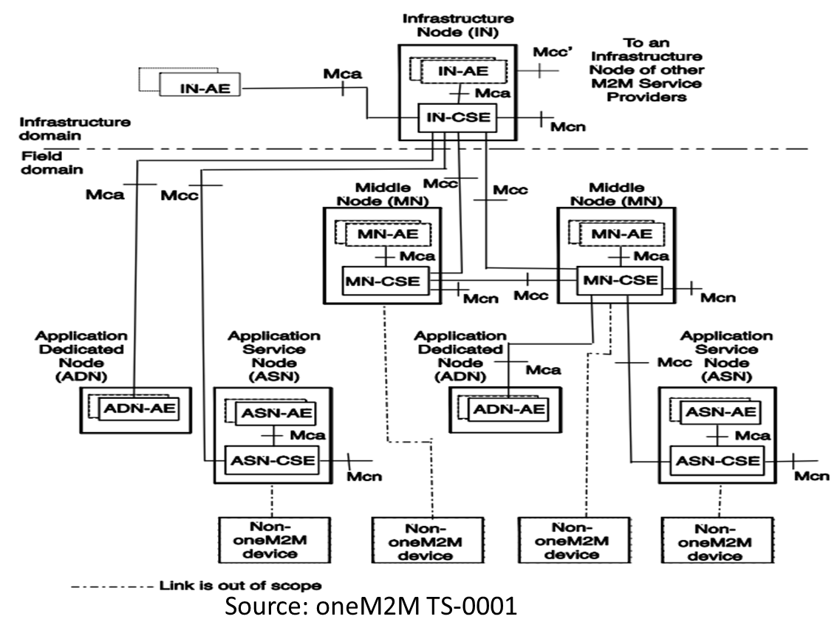
Overall oneM2M Functional Architecture
Notes:
整體的oneM2M 功能架構圖

Slide 65
Concluding Remarks (1)
oneM2M follows a rigorous process to define a high level architecture for IoT/M2M
It starts from use case studies across many use cases to capture sufficient requirements.
Based on these requirements, a high-level IoT/M2M architecture is developed.
The architecture consists of two domains: field domain and infrastructure domain.
Notes:
結語（1）
oneM2M 依照嚴密的程序定義了IoT/M2M的高層級架構, 透過研究使用者案例去列出足夠的需求, 並且根據這些需求去發展一套高層級的IoT/M2M 架構, 這套架構包含field domain 及 infrastructure domain.

Slide 66
Concluding Remarks (2)
Four types of nodes are defined : Application Dedicated Node, Application Service Node, Middle Node and Infrastructure Node.
Four Reference Points are defined: Mcc (CSE-CSE), Mca (CSE-AE), Mcn (CSE-NSE) and Mcc’ (between 2 service providers).
Twelve common service functions are also identified.
These service functions are distributed in the M2M networks and can reside in Application Service Node, Middle Node and Infrastructure Node to support M2M services.
Notes:
結語（2）
一共定義了四種節點, 四種參考點, 十二個一般服務功能, 這些服務功能會分布在M2M網路上, 也可以存在於Application Service Node, Middle Node, 及Infrastructure Node, 並且支援M2M的服務

Slide 67
Where to Find oneM2M Specifications
oneM2M Published Documents
http://www.onem2m.org/technical/published-documents
http://www.onem2m.org/images/files/deliverables/Release2/TR-0001-Use_Cases_Collection-V2.4.1.pdf
oneM2M – Webinars
http://www.onem2m.org/insights/webinars

